Slide 1
Treasurer’s Training
Jessica Farfan
2018

Slide 2
You are Club Treasurer: What Now?
As Club Treasurer, you will be responsible for keeping record of all of the club’s finances and enforcing the ethical and fair usage of the club’s budget.
You will account for all of the incoming/outgoing money.
Thank you for taking on this job!

Slide 3
General Duties
Meet with your team of officers and advisors to develop a budget for the upcoming year
Provide your team with current ledgers at meetings
Report on Income and Spending at meetings
Maintain financial records
Keep an inventory list of club property/equipment.
Complete your Treasurer’s Checklist
Complete your Annual Financial Report
Don’t forget to train next year’s Treasurer!

Slide 4
Ledgers

Slide 5
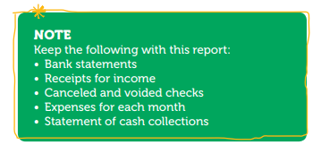
4-H Club Ledgers- Monthly Report
This form is used to record income and expenses to the club on a monthly basis.
Note:
You will be placing your receipts of income, statements of cash collections, etc. in the Deposit Record-Receipts of income tab of your binder
You will be placing your monthly bank statements, check request forms, canceled and voided checks in the Checkbook Balancing Form tab of your binder

Slide 6
4-H Club Project Ledger- Monthly
These are ledgers meant for any separate or specific project groups, large projects and fundraising events.
This should aid you in determining if a fundraiser was successful or not.

Slide 7
Budgets

Slide 8
Club Budget
Look at last year’s numbers to prepare for the upcoming. Know what you are starting out with.
Plan out your fundraising events and income estimates.
Be realistic and know your fixed expenses.
Be specific on what you will be spending on and costs.
Subtract your expenses from your expected income- this should show you if you need to make adjustments to your budget.
A copy of the approved budget must be submitted to the UCCE office for review by the county director or designee by whatever date the local office establishes.

Slide 9
Income & Fundraising

Slide 10
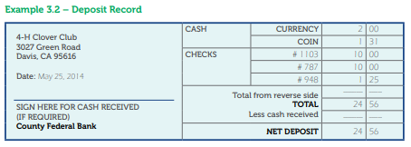
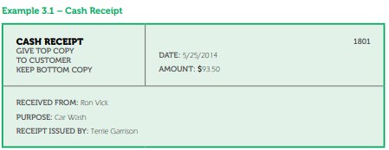
Deposit Record/ Receipts for Income
Depositing and Recording Money
Deposit money within 7 days of receiving
If you will be receiving cash- have a cash box you can lock.
Fill out a deposit record- must be provided to anyone the club receives funds from
If you make a mistake on deposit record, mark VOID and keep for your records
For fundraisers, you may use the 8.8 Monthly Statement of Cash Collections Form if you are unable to provide deposit records.
Don’t forget to record in your Check Register and Ledger!

Slide 11
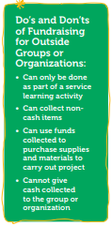
Fundraising Guidelines
Any fundraisers that were not included in the initial budget will have to be approved by your 4-H club’s youth members.
All fundraising activities must be approved by the county director using the Fundraising Approval Form

Slide 12
Donation Receipts
4-H Clubs need to provide a donation receipt to anyone who donated cash or non- cash items.

Slide 13
Spending Money

Slide 14
Your turn: Fill out a check

Slide 15
Sample Check

Slide 16
Checking Account Register
Always ask for a receipt when paying
Do not sign a check until you have the receipt or bill in front of you.

Slide 17
Club Check Request Form
No reimbursements without a receipt or a completed Missing Receipts Form (8.10)

Slide 18
Checkbook Balancing Form
Find the ending balance amount on your bank statement and write it down
Add any deposits that have not cleared to the balance
Subtract any remaining checks that have not cleared from the total above
The balance should match your monthly bank register balance.

Slide 19
Reports

Slide 20
Club Monthly Report
Each month you will need to report to your club what the status of your funds are.
Ask your team what other information they would find helpful to understand or aid in the budget planning during these meetings.

Slide 21
Annual Financial Report
Refer to your monthly bank statement (this should include total income, total expenses, closing balance and any fees) and monthly Checkbook Balancing form to complete your report.
This balance should be what you see on your June bank statement.

Slide 22
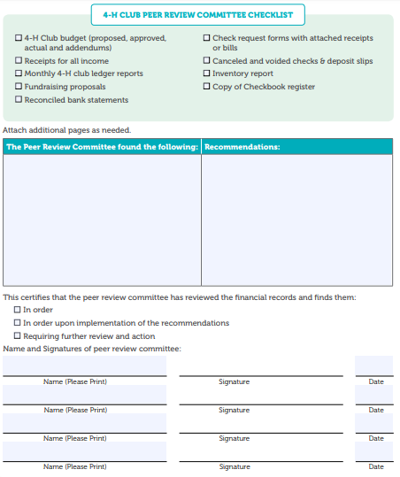
4-H Club Peer Review Committee Report
Form a Peer Review Team to look at your work and open a forum for feedback for the following year.
Team should include:
2--4-H Adult Volunteers
2--4-H members
Team should not include the Treasurer, relatives of the Treasurer or anyone who has authority to sign checks.
Page 1
Page 2

Slide 23
Annual Inventory Report
Any item must be included in Form 6.2, the Annual Inventory Report
Inventory items valued at $1,500 must be entered in the 4-H Annual Financial Reporting System online

